Slide 1

Linear Relationships – Sketching a Line Given $$y=mx+c$$
Year 9 Maths

Slide 2
Contents
Formula Page
Page
Date
Description
2
3

Slide 3

Tasks
24
7
30
Essential Question
You should be ticking these off!
Complete the tasks on this side (left) of your page
Questions
Notes
Steps
Write your notes on this side (right) of your page
Your book, your responsibility!
Summary
Have YOU been doing your summaries?

Slide 4
24
7
30
Date: /9/2018
Linear Relationships
EQ – How do I form a graph from a rule?
25

Slide 5
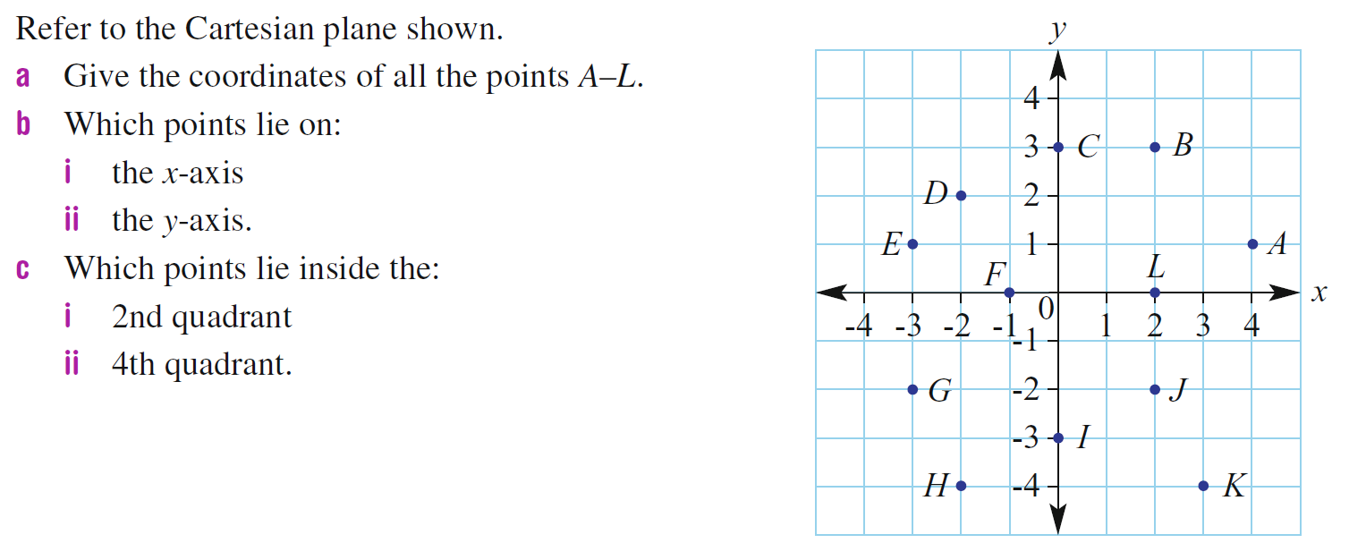


Slide 6
24
7
30
Date: /9/2018
Linear Relationships
EQ – How do I form a graph from a rule?
Use substitution to fill in the table.
Example: Draw a graph of the equation y = 2x +1
If x = 0 , y =1 If x = 1 , y =3 If x =2, y= 5
y = 2(0) +1
x | 0 | 1 | 2 | 3
y | 1 | 3 | 5 | 7
25

Slide 7
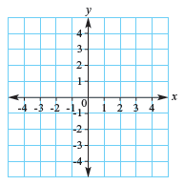
24
7
30
Date: /9/2018
Linear Relationships
EQ – How do I form a graph from a rule?
Use substitution to fill in the table.
Example: Draw a graph of the equation y = 2x +1
If x = 0 , y =1 If x = 1 , y =3 If x =2, y= 5
y = 2(0) +1
x | 0 | 1 | 2 | 3
y | 1 | 3 | 5 | 7
Next, use these values as coordinates and plot them on the axes. Then join them up with a straight line (use a ruler), putting arrows on the end indicating the line goes on forever
25

Slide 8
24
7
30
Date: /9/2018
Linear Relationships
EQ – How do I form a graph from a rule?
Use substitution to fill in the table.
Example: Draw a graph of the equation y = 2x +1
If x = 0 , y =1 If x = 1 , y =3 If x =2, y= 5
y = 2(0) +1
x | 0 | 1 | 2 | 3
y | 1 | 3 | 5 | 7
Next, use these values as coordinates and plot them on the axes. Then join them up with a straight line (use a ruler), putting arrows on the end indicating the line goes on forever
25

Slide 9
24
7
30
Date: /9/2018
Linear Relationships
EQ – How do I form a graph from a rule?
Use substitution to fill in the table.
Example: Draw a graph of the equation y = 2x +1
If x = 0 , y =1 If x = 1 , y =3 If x =2, y= 5
y = 2(0) +1
x | 0 | 1 | 2 | 3
y | 1 | 3 | 5 | 7
Next, use these values as coordinates and plot them on the axes. Then join them up with a straight line (use a ruler), putting arrows on the end indicating the line goes on forever
25

Slide 10
Task
Dwyer Page 53- All questions
Fast finishers- Q 9, 6, 8 Essentials Book (pg 200)

Slide 11
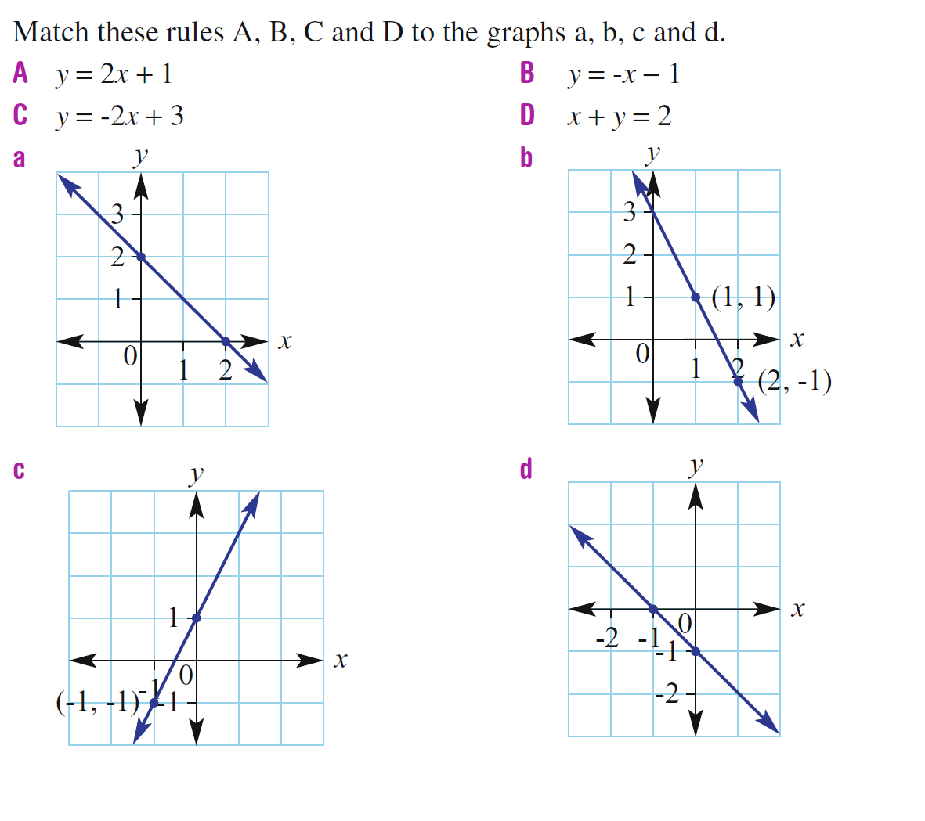

Slide 12
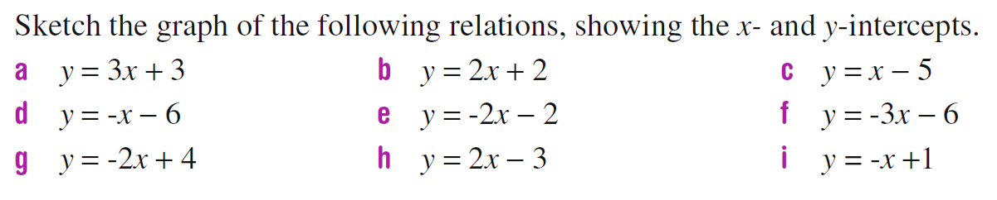
Task

Slide 13
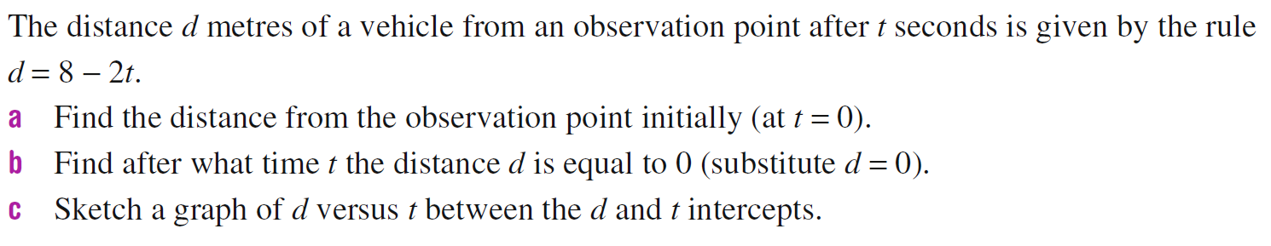
TAsk

